Slide 1
Practical Lessons From Creating the Control-Alt-Hack™ Card Game
Research Challenges for
Games In Education and Research
Tamara “Tammy” Denning
Adam “Adam” Shostack
Tadayoshi “Yoshi” Kohno
University of Washington

Slide 2
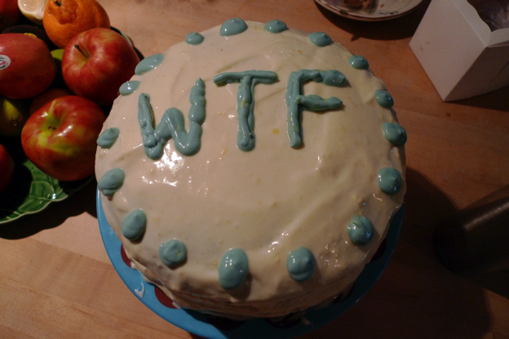
….aka, a talk about cake.

Slide 3
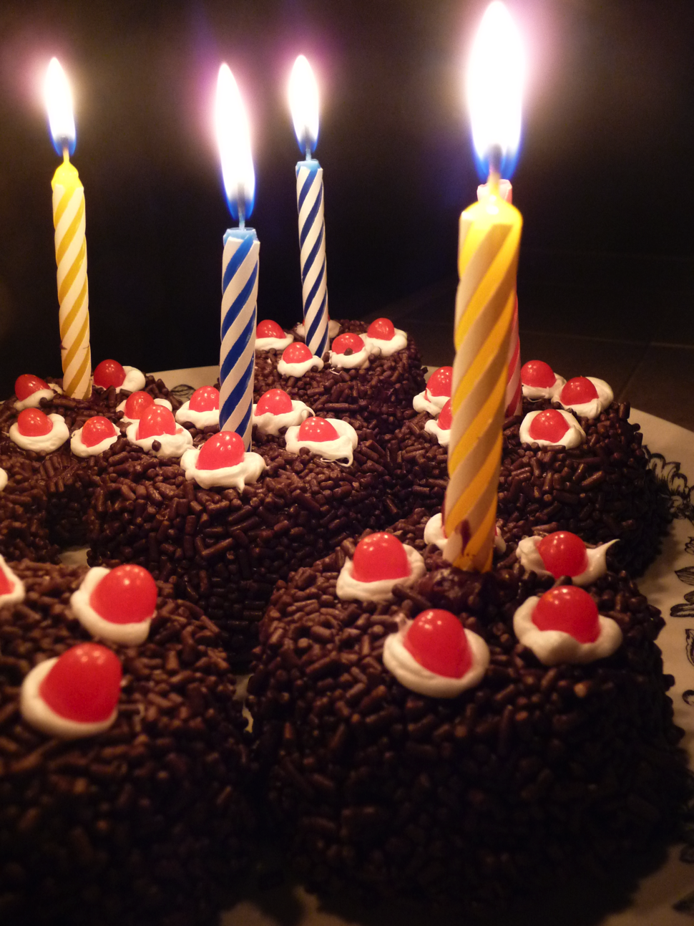
You can have your cake and eat it too.

Slide 4
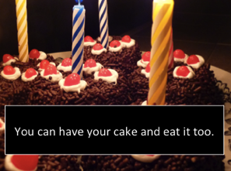
Diversify positive outcomes
Primary design goal was for recreational, voluntary play
Evaluated (and published) on the classroom context

Slide 5
Diversify positive outcomes
Primary target audience was age 18-30 in CS and STEM
First interested (evangelizing?) group was security-minded

Slide 6
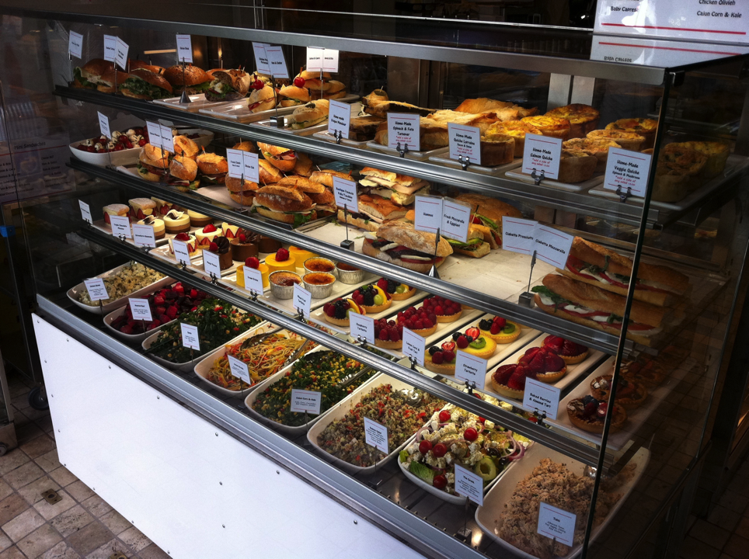
You can’t have all the cakes.

Slide 7
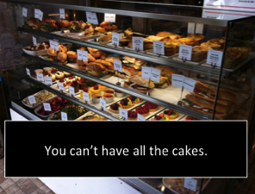
Prioritize
Tradeoffs between:
Control over details
Calendar time
Person-hours
Cost
Quality

Slide 8
Prioritize
Target audience & play context influences:
Graphic design & illustration
Properties of mechanics
Level of technical detail
Jokes/references to include
Mechanics choice

Slide 9
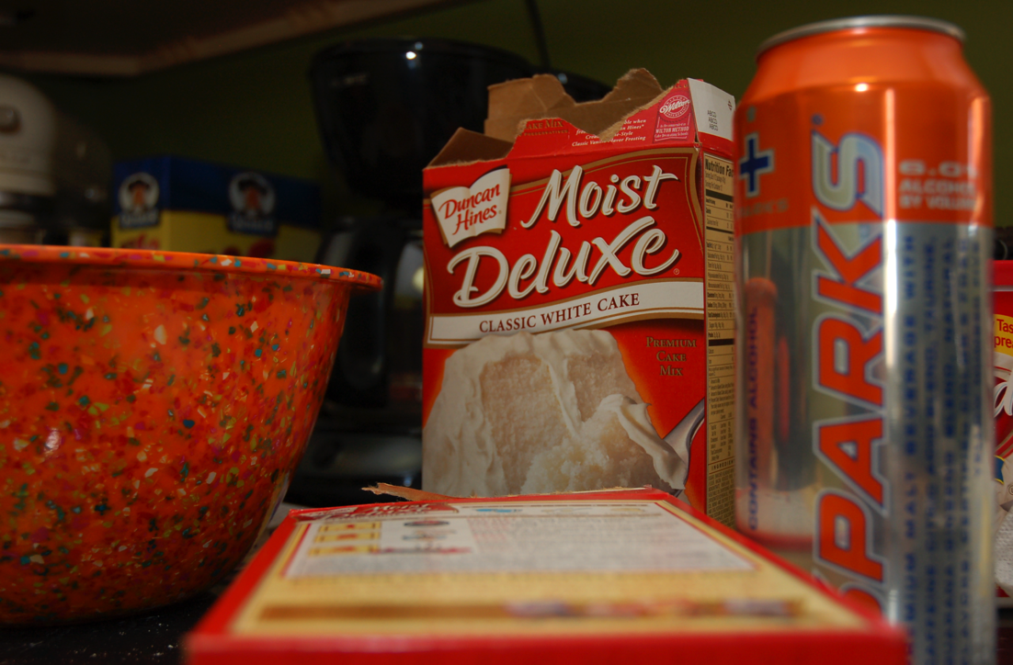
You don’t have to start from scratch.

Slide 10
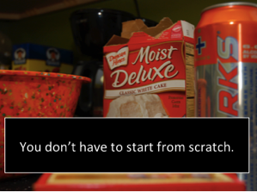
Pre-Existing Mechanics
You’re probably not a master at gaming mechanics
Put your time & effort on the important parts

Slide 11
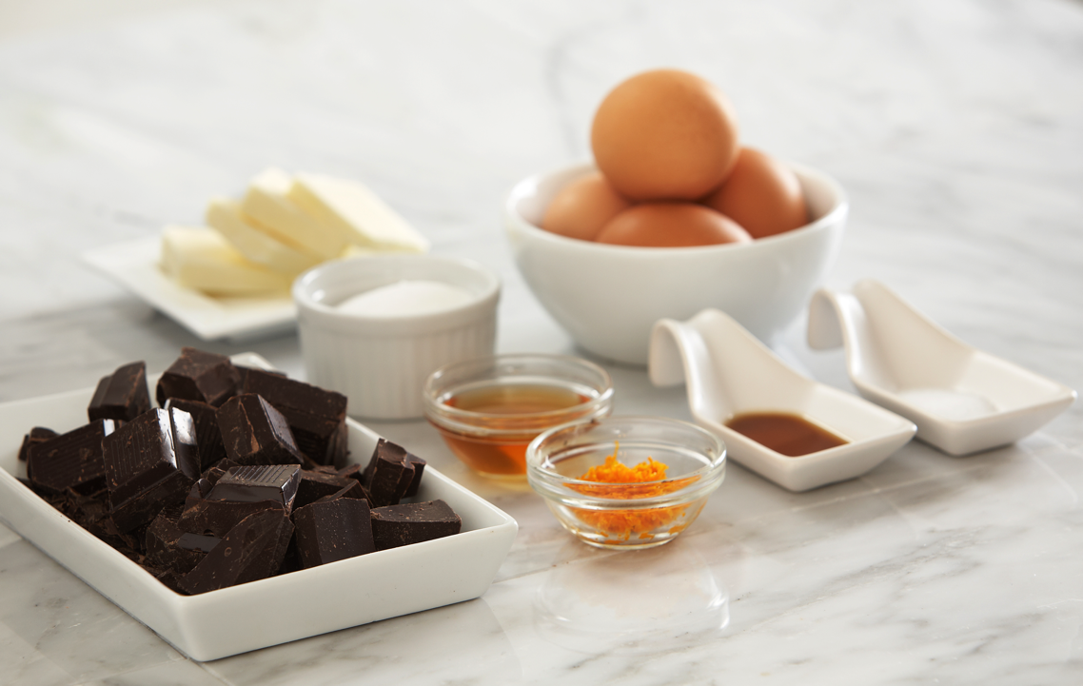
Use quality ingredients.

Slide 12
Locating Expertise
Many people (can be) involved:
Mechanics Designer
License Coordinator
Graphic Designer
Illustrator
Manufacturer
Production Manager
Trademark Lawyer
Distributor
Retailer

Slide 13
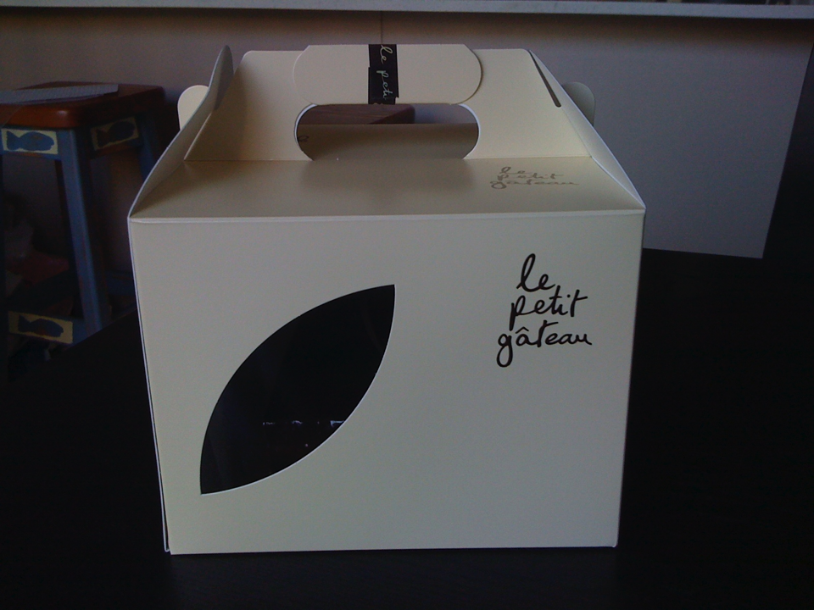
Decide how to serve your cake.

Slide 14
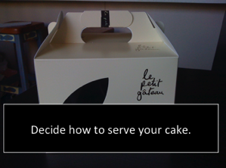
Distribution/Production Decisions
Download and self-print
Print-on-demand
Domestic (Smaller) Print Run
International (Larger) Print Run

Slide 15
Distribution/Production Decisions
Tradeoffs between:
Cost per unit
Customizability
Quality
Minimum order size

Slide 16
Distribution/Production Decisions
Affects:
Timeline
Graphic Design/Illustration Parameters
Budget

Slide 18
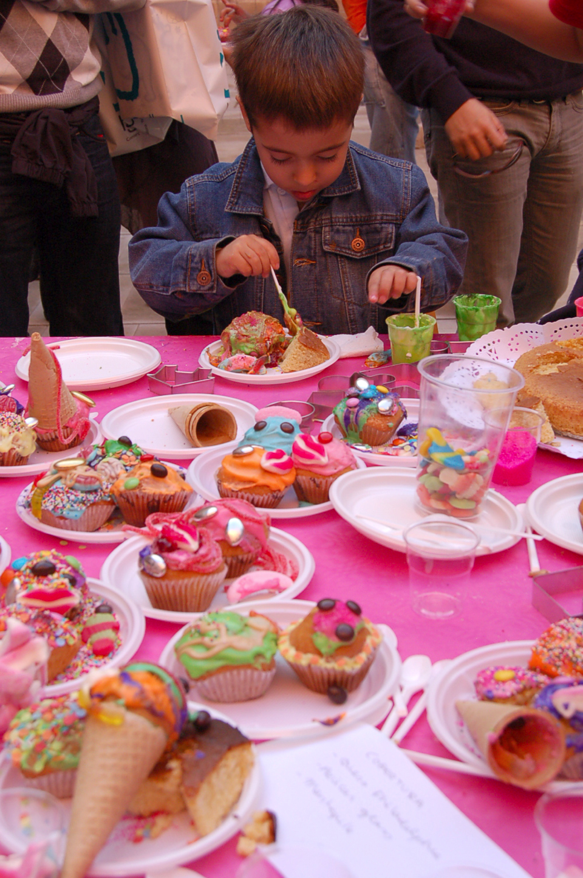
Can you have too much cake?

Slide 19
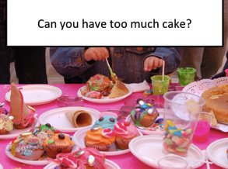
Games in the Classroom
Red Queen Effect

Slide 20
Games in the Classroom
Red Queen Effect
Excessive focus on mechanics

Slide 21
Games in the Classroom
Red Queen Effect
Excessive focus on mechanics
Oversaturation

Slide 22
What are the long-term consequences
of cake?

Slide 23
Research and Evaluation
Metrics for more nebulous goals

Slide 24
Research and Evaluation
Metrics for more nebulous goals
Isolating conflating variables

Slide 25
Research and Evaluation
Metrics for more nebulous goals
Isolating conflating variables
Evaluations for different stages/styles of research

Slide 26
Research and Evaluation
Metrics for more nebulous goals
Isolating conflating variables
Evaluations for different stages/styles of research
Research investment vs. research yield

Slide 27
Thanks. Questions?

